Slide 1
Transportation and Data Science
Presented by : Raghu, Samarth and Alex
Notes:
Introduce.
Why this topic?
Problems related transportation, How it impacts our lives and how data science can be used to approach these problems.

Slide 2
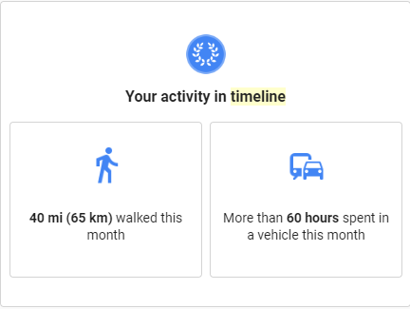
Stats from Google!

Slide 3
60 hours spent in vehicle:
= Equals to 75% of the time I spend on my on campus job
~100 % of time I spend on recreational activities
~ 100 % Time I spend with my friends and family
Minimum wage in Oregon = 11.25 USD
60 *11.25 = 675 USD ~ Housing + utilities cost.

Slide 4
How does transportation impact you?
Notes:
Think of

Slide 5
Commute time

Slide 6
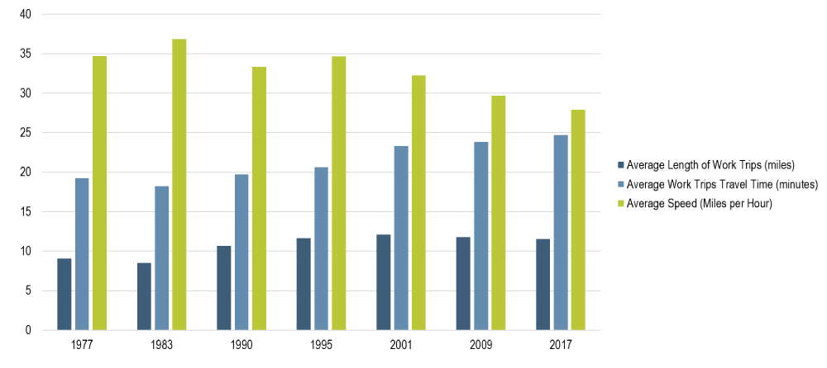
Home-to-Work Commute Profile, United States, 1977-2017
Notes:
Source: U.S. Department of Transportation, BTS
https://transportgeography.org/?page_id=5134
Till 1995 commuting was generally improving in terms of speed, even if the average commuting distance was increasing. The suburbanization of housing and employment was taking place at a quick pace, but its impacts on congestion remained marginal.

Slide 7
Economic development

Slide 8
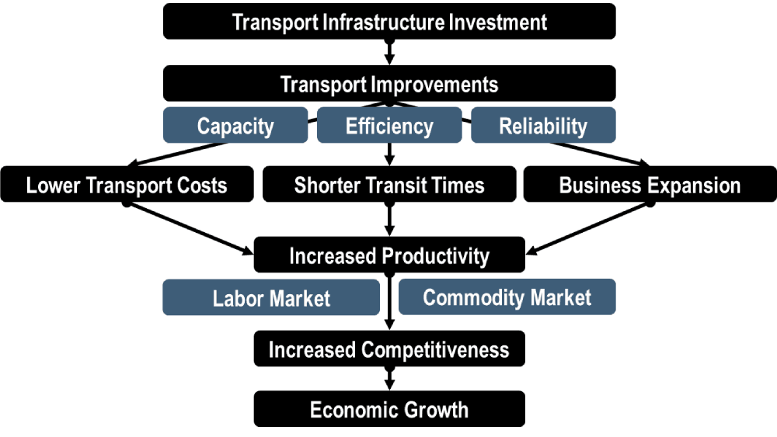
Transport Impacts on Economic Opportunities

Slide 9
Climate change

Slide 10
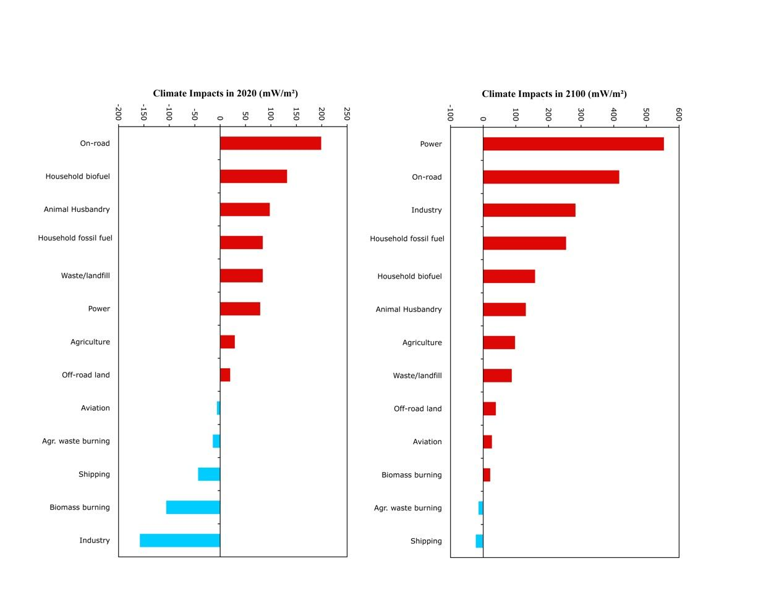
Notes:
The industrial sector releases such a high proportion of sulfates and other cooling aerosols that it actually contributes a significant amount of cooling to the system
Warming should accelerate as we continue to remove the aerosols," said Unger. "We have no choice but to remove the aerosol particulate pollution to protect human and ecosystem health. That means we'll need to work even harder to reduce greenhouse gases and warming pollutants."
Source:

Slide 11
Transportation and Data Science - Approach
Problem definition
Data collection
Data Cleaning
Data Analysis
Inferences and retrospective.

Slide 12
Problem Definition
What are you hoping to accomplish?
Congestion control
Travel time predictions
New route decisions
Sustainable transportation
Affordable transportation
Toll collection decisions
Notes:
Number of Toll gates: Affordable transportation vs Sustainable transportation
Air quality: Sustainable transportation vs Travel time predictions
Cost factor: Congestion management vs Affordable transportation

Slide 13
Problem Definition
Problem statement: What are we trying to achieve?
Defined questions: What answers do you need to understand/solve the problem?
Attribute selection: What data do you need to answer these questions.

Slide 14
Data collection
Inductive loop
High Definition Radars
Bluetooth devices

Slide 15
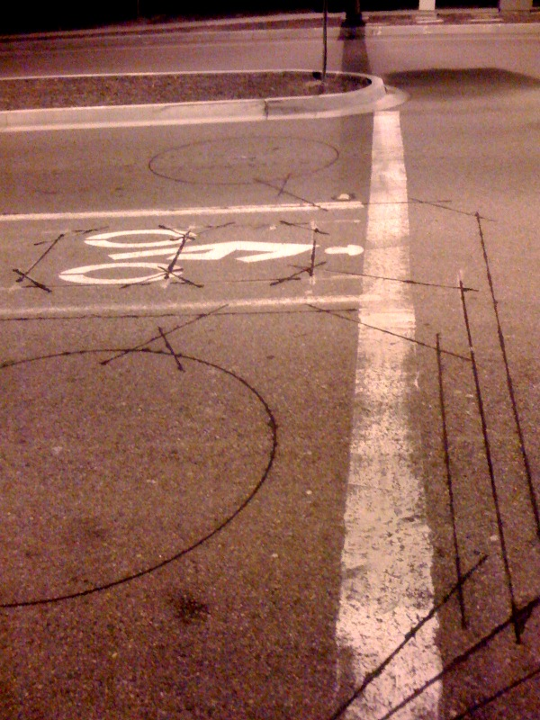
Induction loops:

Slide 16
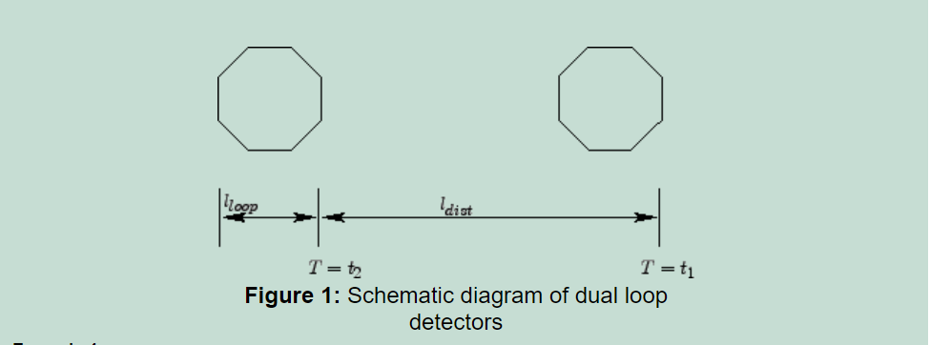
Dual
Notes:
https://nptel.ac.in/courses/105101008/525_AutoLoop/point4/point.html

Slide 17
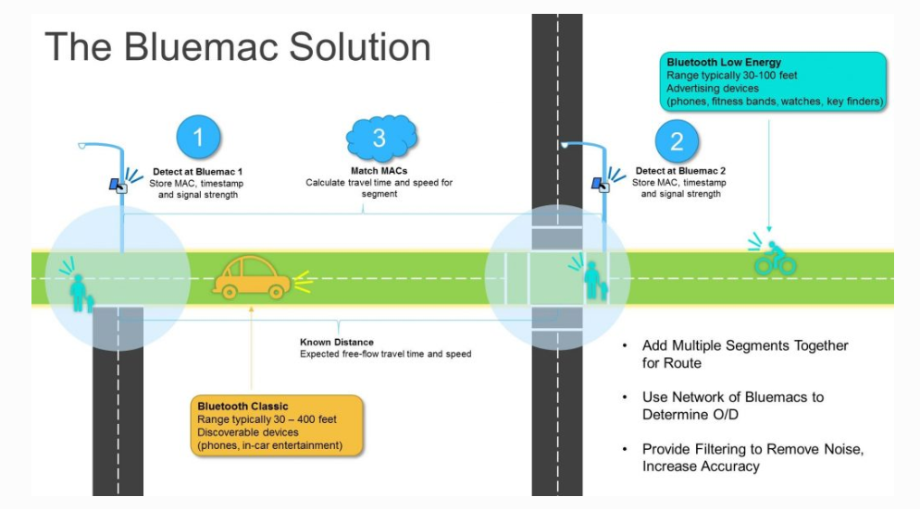
Bluemac
Notes:
https://www.bluemacanalytics.com/technology/

Slide 18

Radar

Slide 19
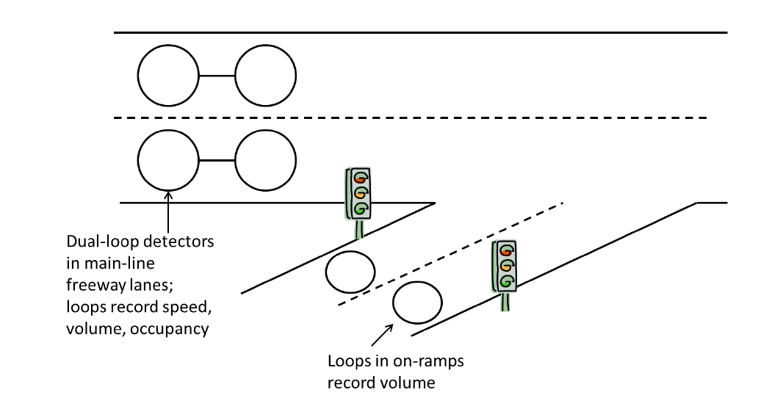
PORTAL
Loop Detectors:

Slide 20
Data collected by ODOT
ODOT collects information about every vehicle and we can view these data on the PORTAL website.
http://new.portal.its.pdx.edu:8080/highways/
Portal lets us specify all the parameters for the data we need and organizes it for us.
For the scope of our project, we are dealing with only a couple of attributes given in the dataset.

Slide 21
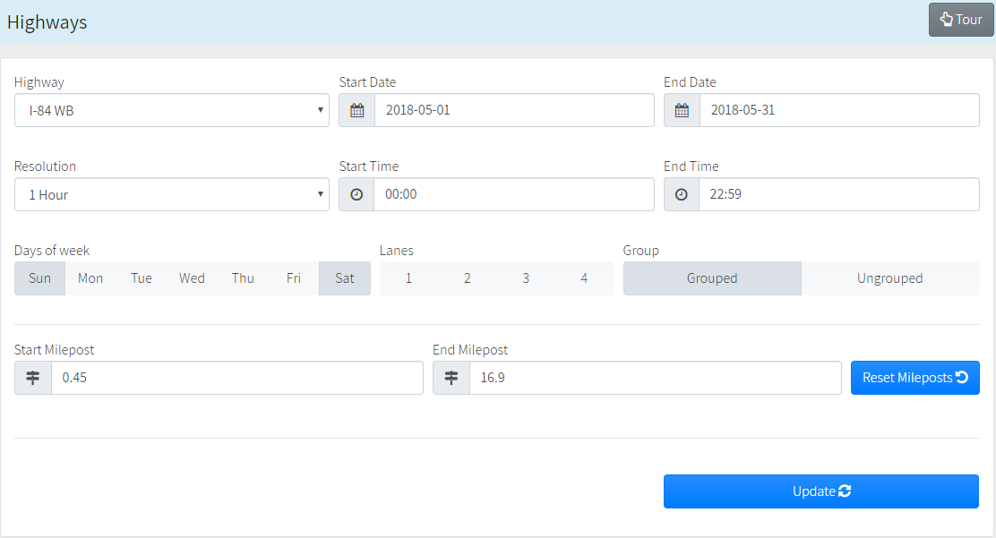

Slide 22
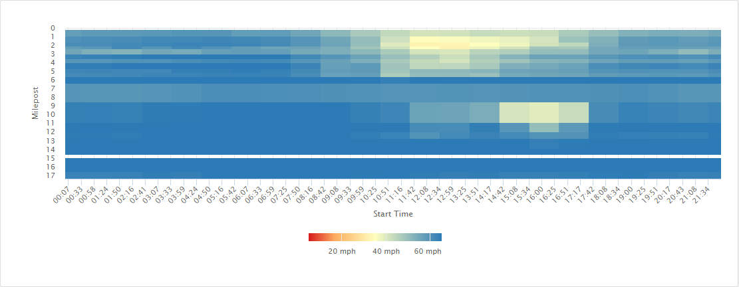
Heatmap

Slide 23
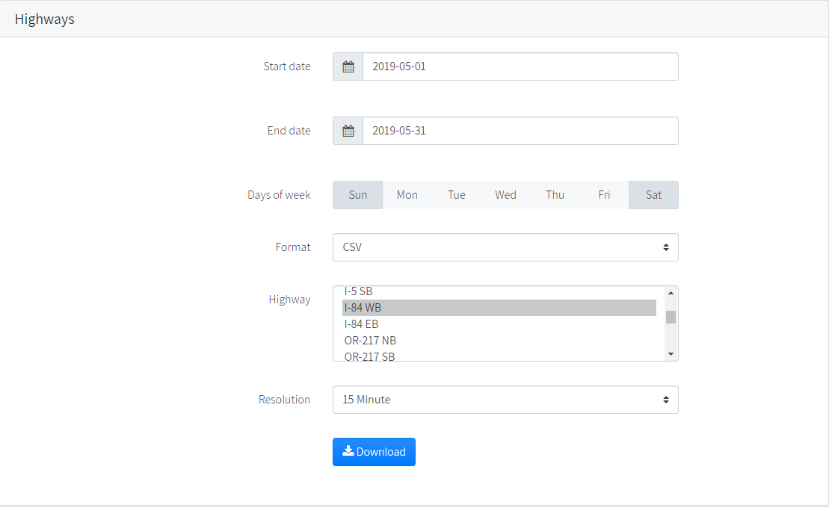

Slide 24
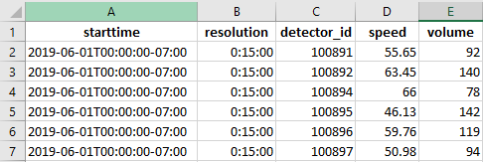
Highway Data
Time
Resolution
Detector ID
Speed
Volume

Slide 25
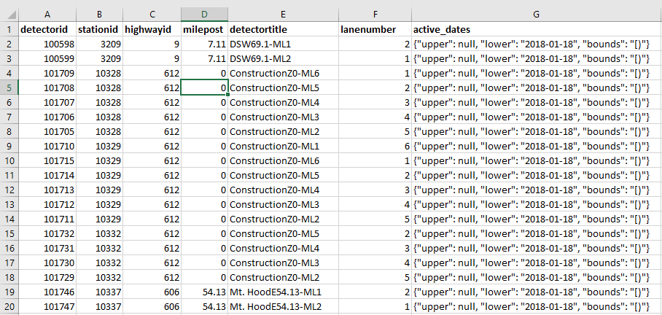
Detector Metadata
Detector ID
Station ID
Highway ID
Detectortitle
Milepost
Lane Number
Active_Dates

Slide 26


Data Cleaning
Remove unwanted observations.
Remove duplicates
Remove irrelevant observations

Slide 27
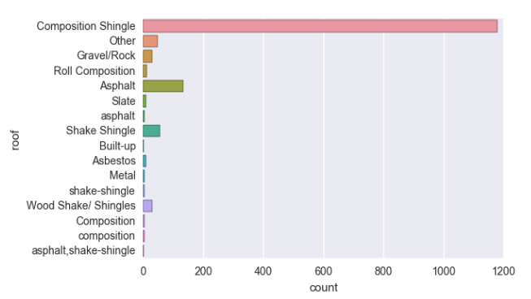
Data Cleaning
2. Fix Structural Errors.
(For instance, you can check for typos or inconsistent capitalization)

Slide 28
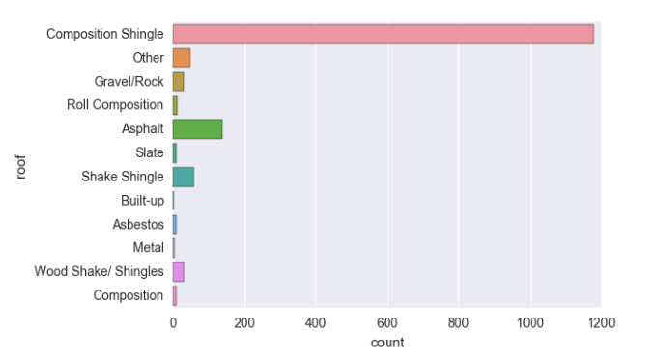
Data Cleaning
2. Fix Structural Errors.

Slide 29

Data Cleaning
3. Filter Unwanted Outliers.

Slide 30
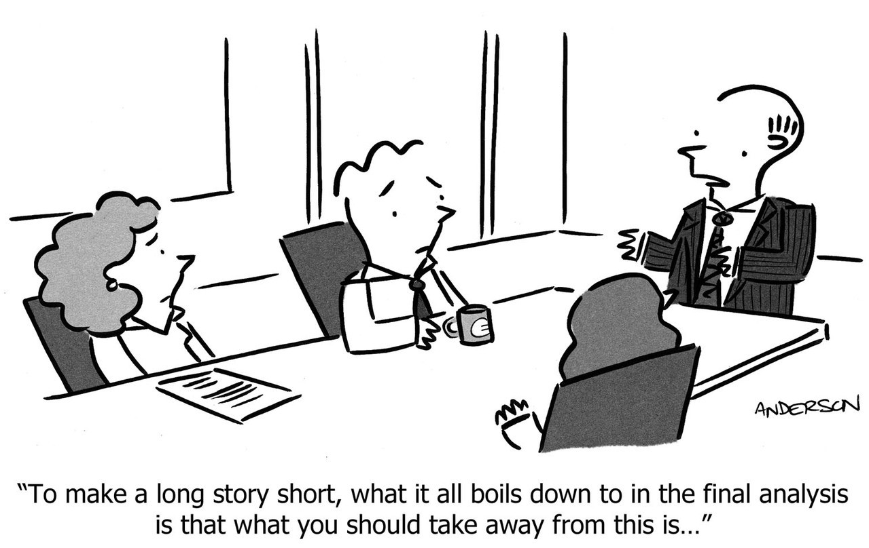
Ok, now what are we going to do with this data?

Slide 31
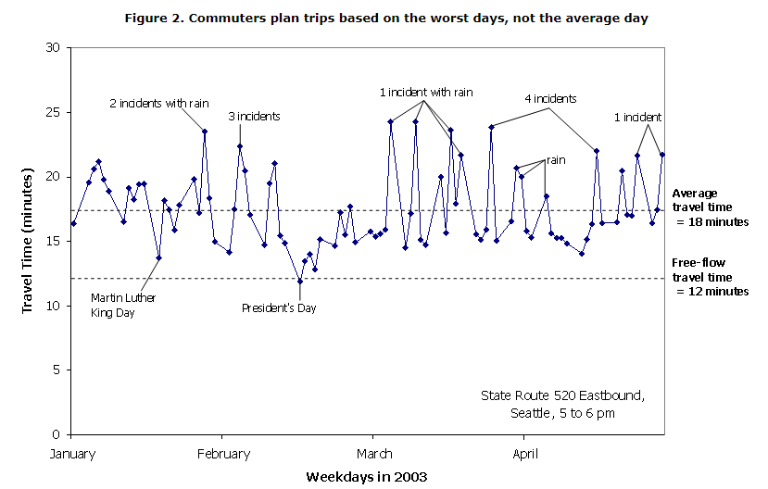
Travel time reliability, Traffic Congestion & Incident
Travel time reliability is the consistency or dependability in travel times, as measured from day-to-day and/or across different times of the day.
Traffic congestion is a condition on road networks that occurs as use increases, and is characterized by slower speeds, longer trip times, and increased vehicular queueing.
The definition of a road traffic incident occurs when a vehicle that is moving along a roadway collides with another vehicle or object.

Slide 32
Analysis and Interpretation

Slide 33
https://www.reddit.com/r/IdiotsInCars/comments/cj1pio/traffic_backed_up_just_exit_whenever_you_want/

Slide 34
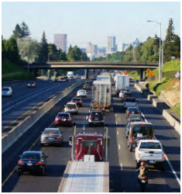
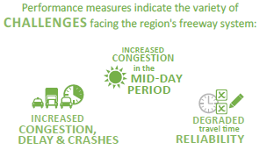
2018 ODOT Traffic Performance Report
Compiled every two years by Oregon Department of Transportation
Data sources include PORTAL, HERE
Stated purpose is to provide a baseline for long-term monitoring to enable ODOT to better understand mobility conditions of the freeway system
Notes:
https://www.here.com/products/traffic-solutions/real-time-traffic-information
https://catalog.data.gov/dataset/automatic-traffic-recorder-atr-stations

Slide 35
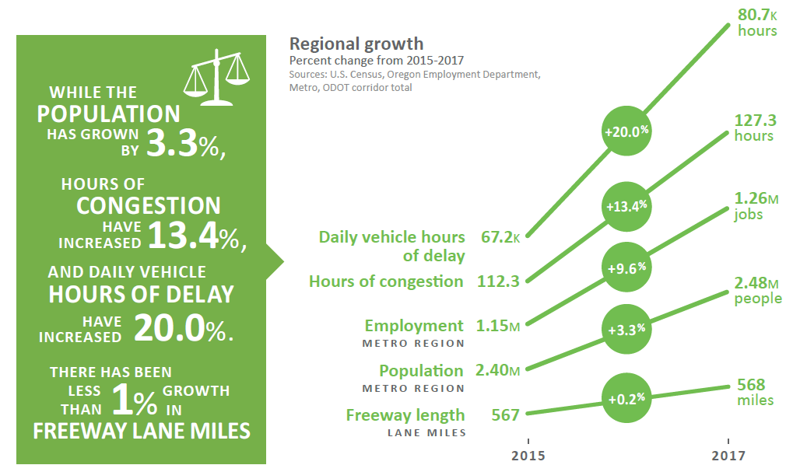
Regional Growth

Slide 36
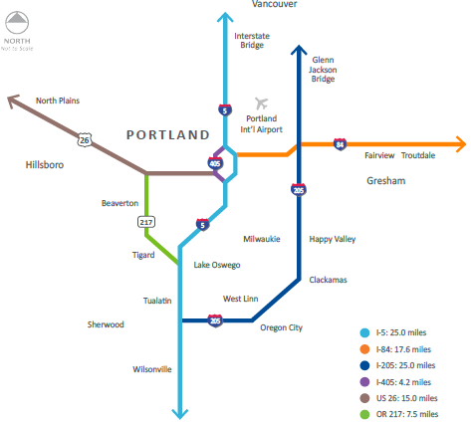
ODOT Traffic Performance Report Metrics
Hours of congestion
Cumulative hours that drivers spend in congestion
Travel time
Time required to travel from one end of a corridor to another
Recurring bottlenecks
freeway segments where traffic congestion regularly occurs and average speeds drop below 75% of free-flow speed.
Notes:
Congested conditions can range from slowing (40-50 mph) to
congested (30-40 mph) to severely congested (less than 30 mph).

Slide 37
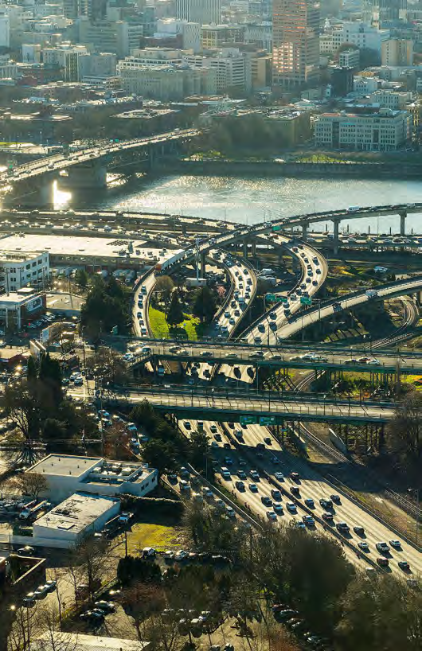
I-84 Westbound
Hours of Congestion (Measured at I-205 interchange)
2015: 13.3 hours
2017: 13.8 hours (3.8% increase)
Vehicle Hours of Delay
2015: 5,680 hours
2017: 6,745 (18.8% increase)
Travel Time (AM)
2015: 28.3 minutes
2017: 30.1 minutes (6.4% increase)
Bottlenecks
Between 1-205 and I-5

Slide 38
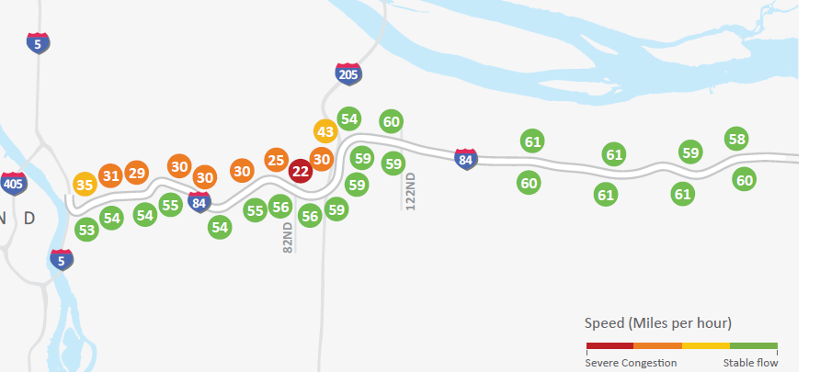
I-84 Average Speeds (AM.)

Slide 39
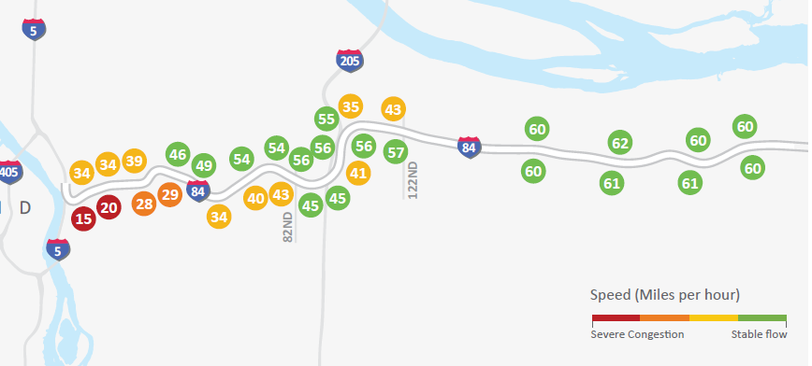
I-84 Average Speeds (PM.)

Slide 40
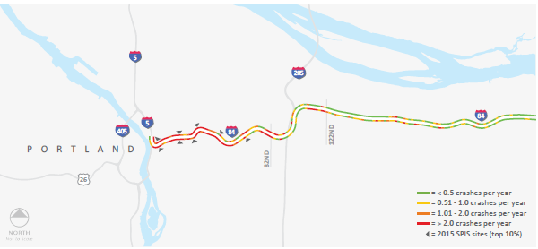
I-84 Crash frequency per 1/10th mile (2013-2017)
Notes:
Safety Priority Index System Reports
Legally reportable motor vehicle traffic crashes are those involving death, bodily injury, damage to personal property in excess of $2,500; or damage to any vehicle over $2500 and any vehicle is towed from the scene as a result of damage (effective 1/1/2017)

Slide 41
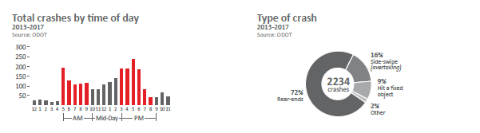
I-84 Crashes by time of day and type

Slide 42
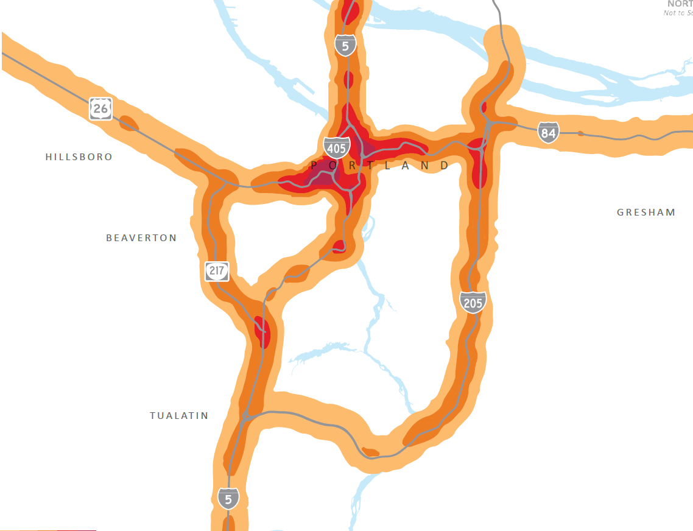
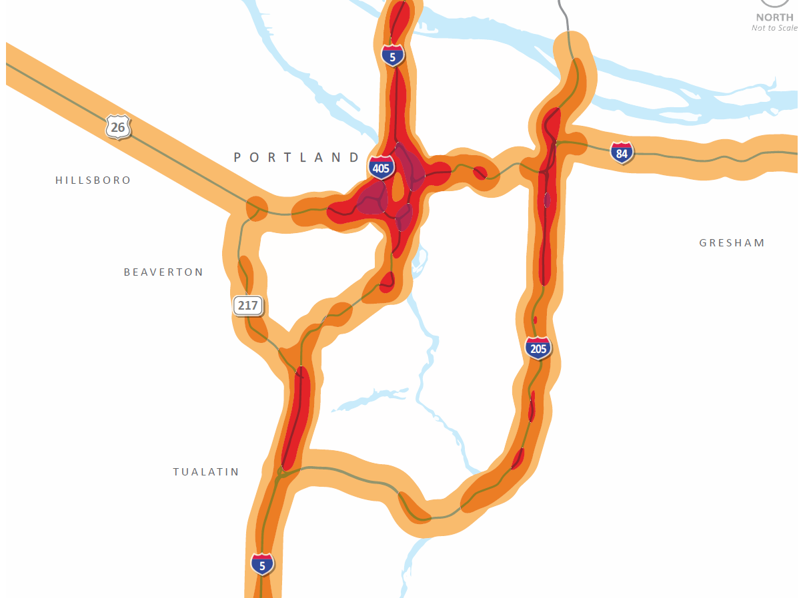
Crashes (2016 and 2018 reports)
Crashes 2011-2015 Crashes 2013-2017

Slide 43
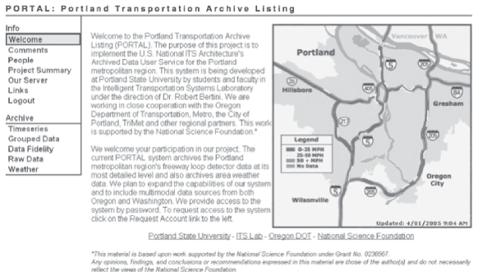
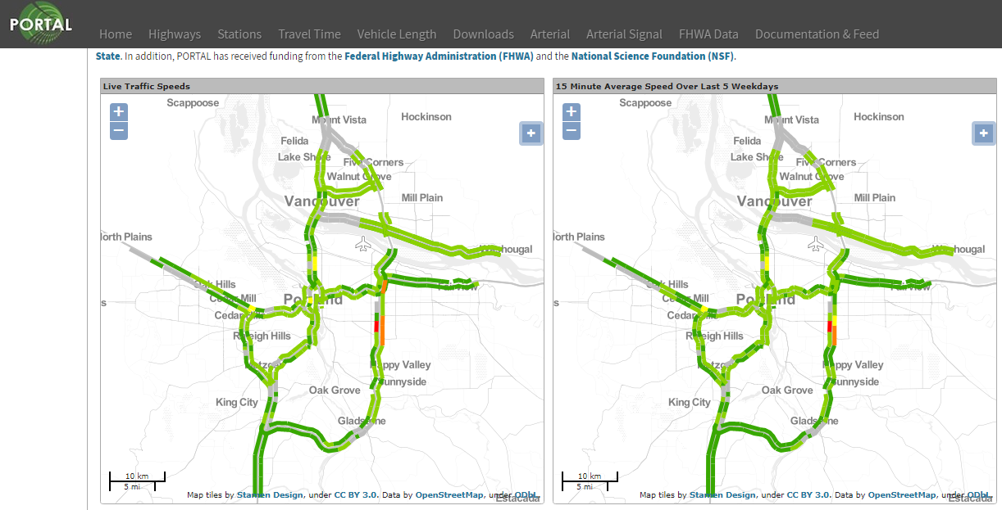
PORTAL 10 Year Retrospective (Tufte, Bertini, Harvey)

Slide 44
PORTAL Growth
2004
Data gathered strictly from freeway loop detectors in Oregon
2014
Data gathered from loop detectors, Wavetronix and Bluetooth from freeways and arterials
Expanded to include Vancouver area
WA data recorded as strings, wasn’t 20 second resolution
3TB of data

Slide 45
PORTAL Uses
Agency Performance Reporting
ODOT Performance Report
ODOT Bottleneck Analysis
2009 Corridor Bottleneck Operations Study
Identified and prioritized investments to improve mobility and safety
2013 Project Atlas: Corridor Bottleneck Operations Study
Advanced Traffic and Incident Management
Variable Advisory Speed signs
Variable Message Signs
Dynamic Ramp Metering

Slide 46
Educational Uses
PORTAL website has been cited in 93 Google Scholar articles.
PORTAL Data has been used in PSU courses:
Computer Science
Cloud and Cluster Data Management
Civil and Environmental Engineering
Urban Transportation Systems
Introduction to Multimodal Transportation Engineering Data Analysis
Book: Understanding and Communicating Multimodal Transportation Data

Slide 47
Questions?

